Slide 1
Asia Pacific

Slide 2
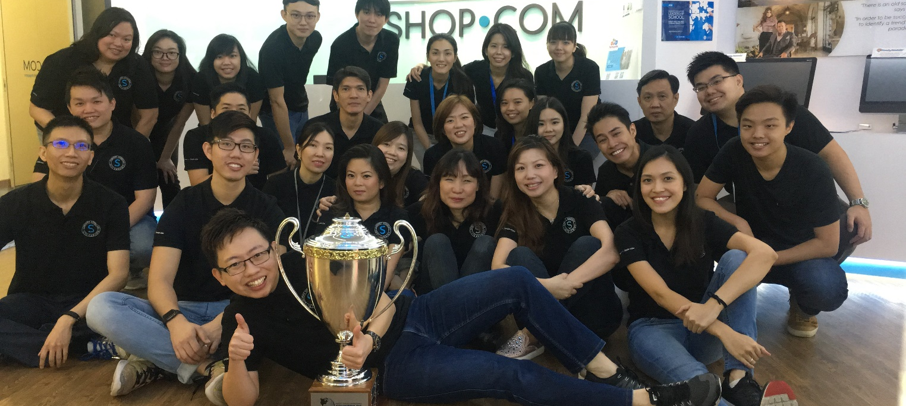
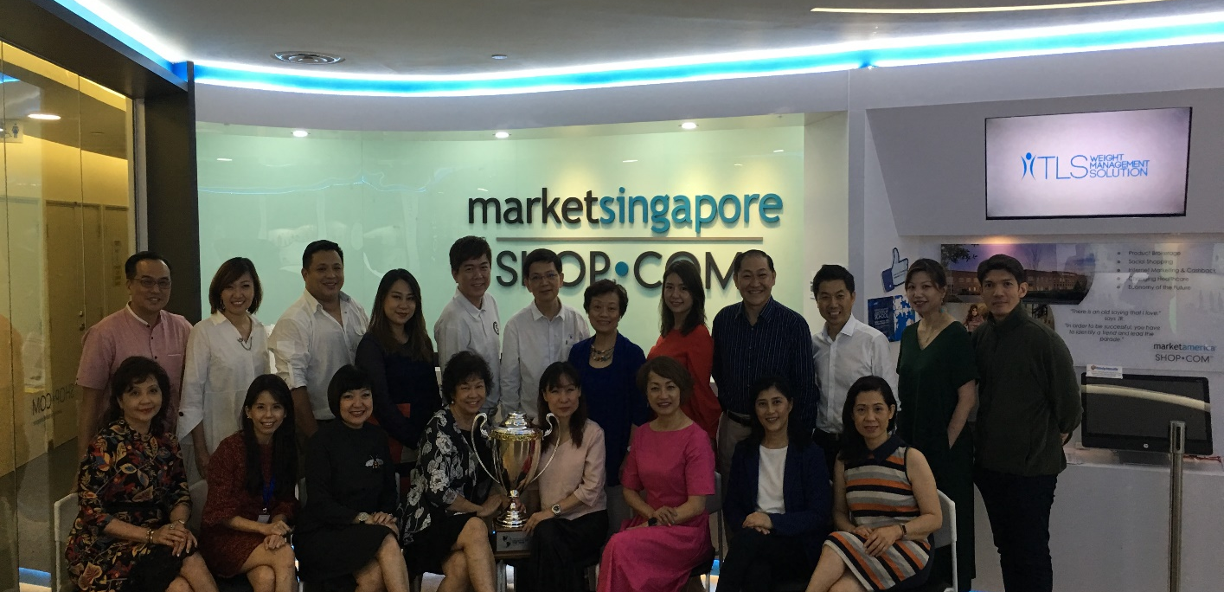
Country of the Year Award 2018

Slide 3
Malaysia
2017
Singapore
2014
1 Account
5 Markets
Hong Kong
2007
Taiwan
2005
Australia
2003

Slide 4
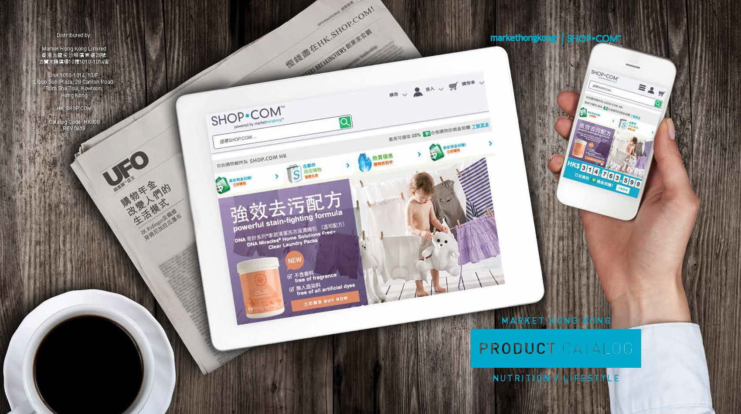
Develop your
Retail Business
Start your business with Base 10 Seven Strong
Retail products in each market via SHOP.COM
Receive retail profit into your home-country account
Earn & Use cashback &
in each market

Slide 5
Build your Organisation

Slide 6
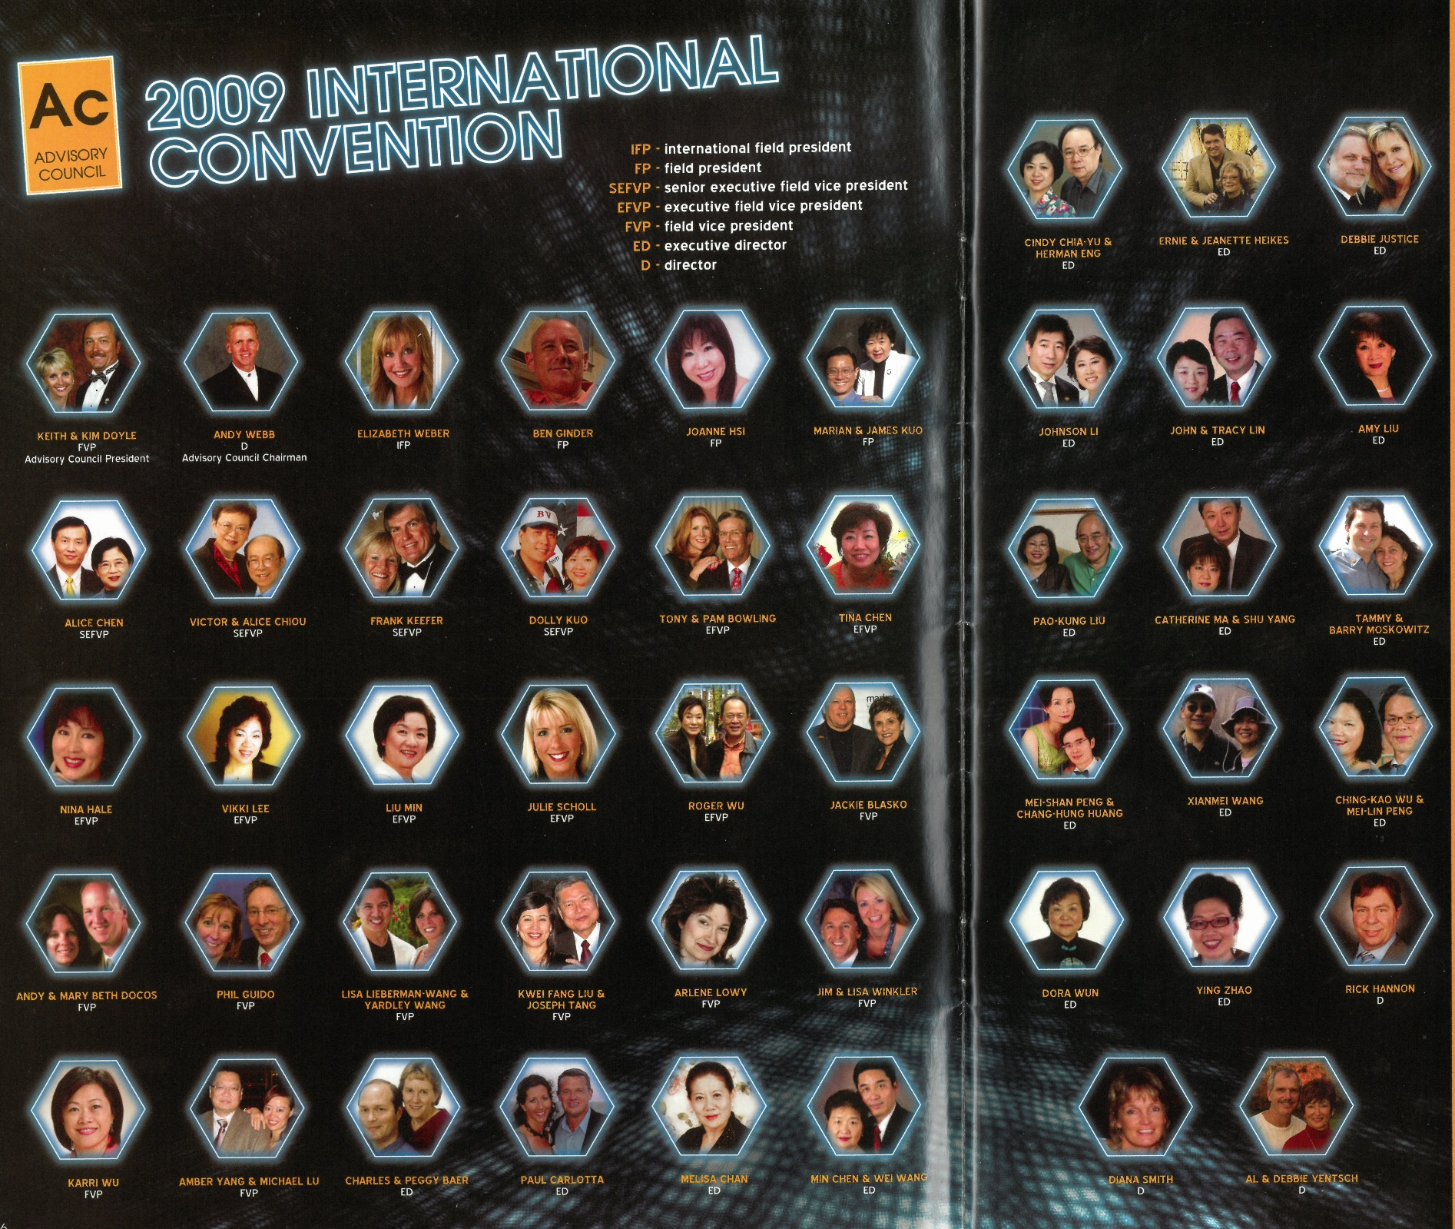
2009 Advisory Council

Slide 7
2018 Advisory Council

Slide 8
Leverage with
GMTSS
UnFranchise® Business Presentation
New UnFranchise ® Owner Training
Basic 5 Training
Executive Coordinator Certified Training
Local Seminar
Product Symposium
Annual Convention
Leadership School
Product Training
Motives / TLS / WebCenter

Slide 10
Malaysia Leadership Council (MLC) established
First monthly meeting Aug 2018
Strengthen communication between corporate and field leaders

Slide 11
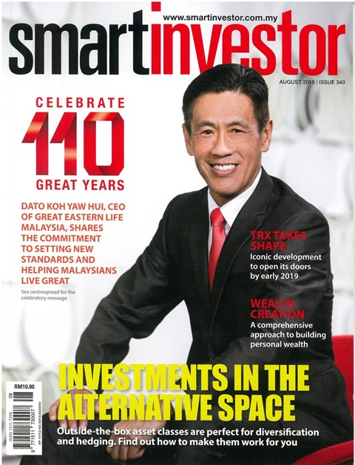
Media Coverage with Smartinvestor Magazine
Brand Building
Preview a different business concept

Slide 13
First ever SHOP DAY with Partner Store
Help build your Shopping Annuity
Shopping Night exclusively for MHK members
Onsite new Preferred Customers registered
First time in MA history

Slide 14
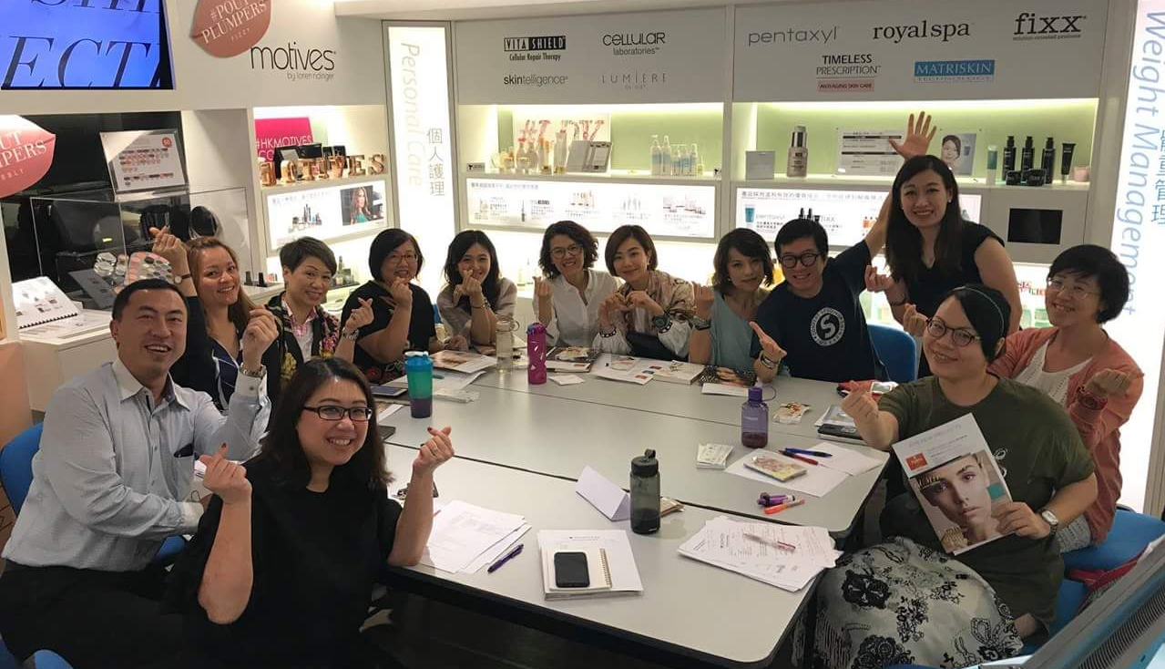
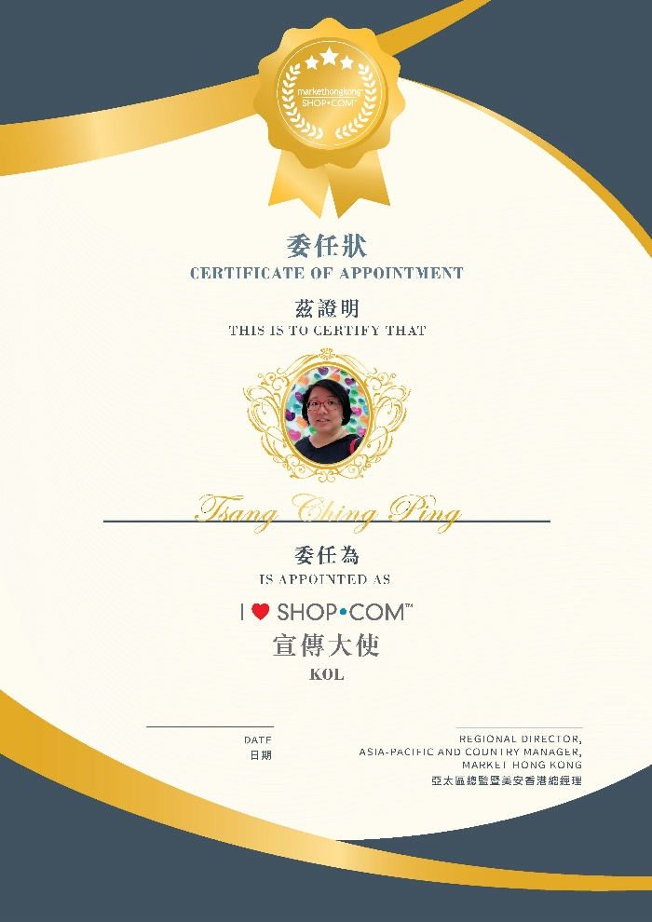
Mission
To help more people get to know this one stop shopping platform that covers everything and give cashback with great deal.
KOL
Action
Selected from UFOs who love to shop on HK.SHOP.COM with proven track record.
Through Social Media to share and promote their shopping experience on SHOP.COM.

Slide 16
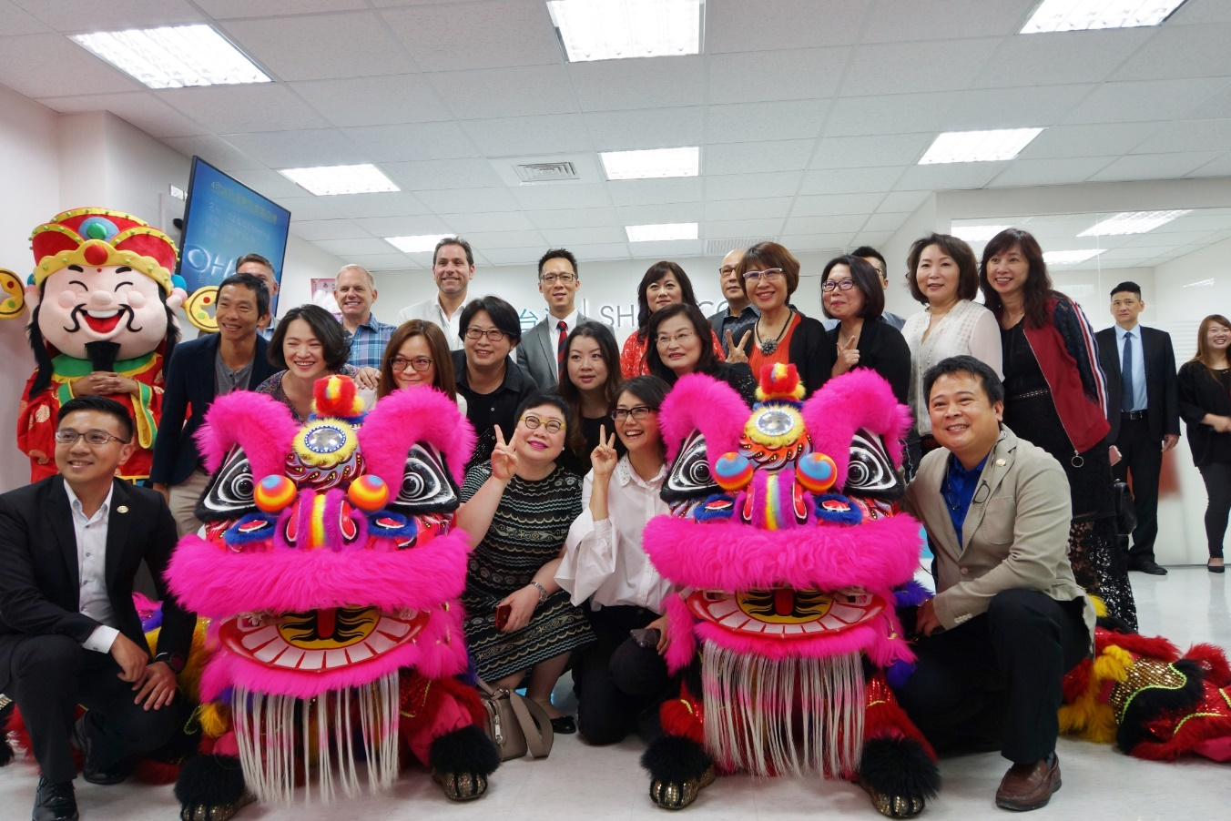
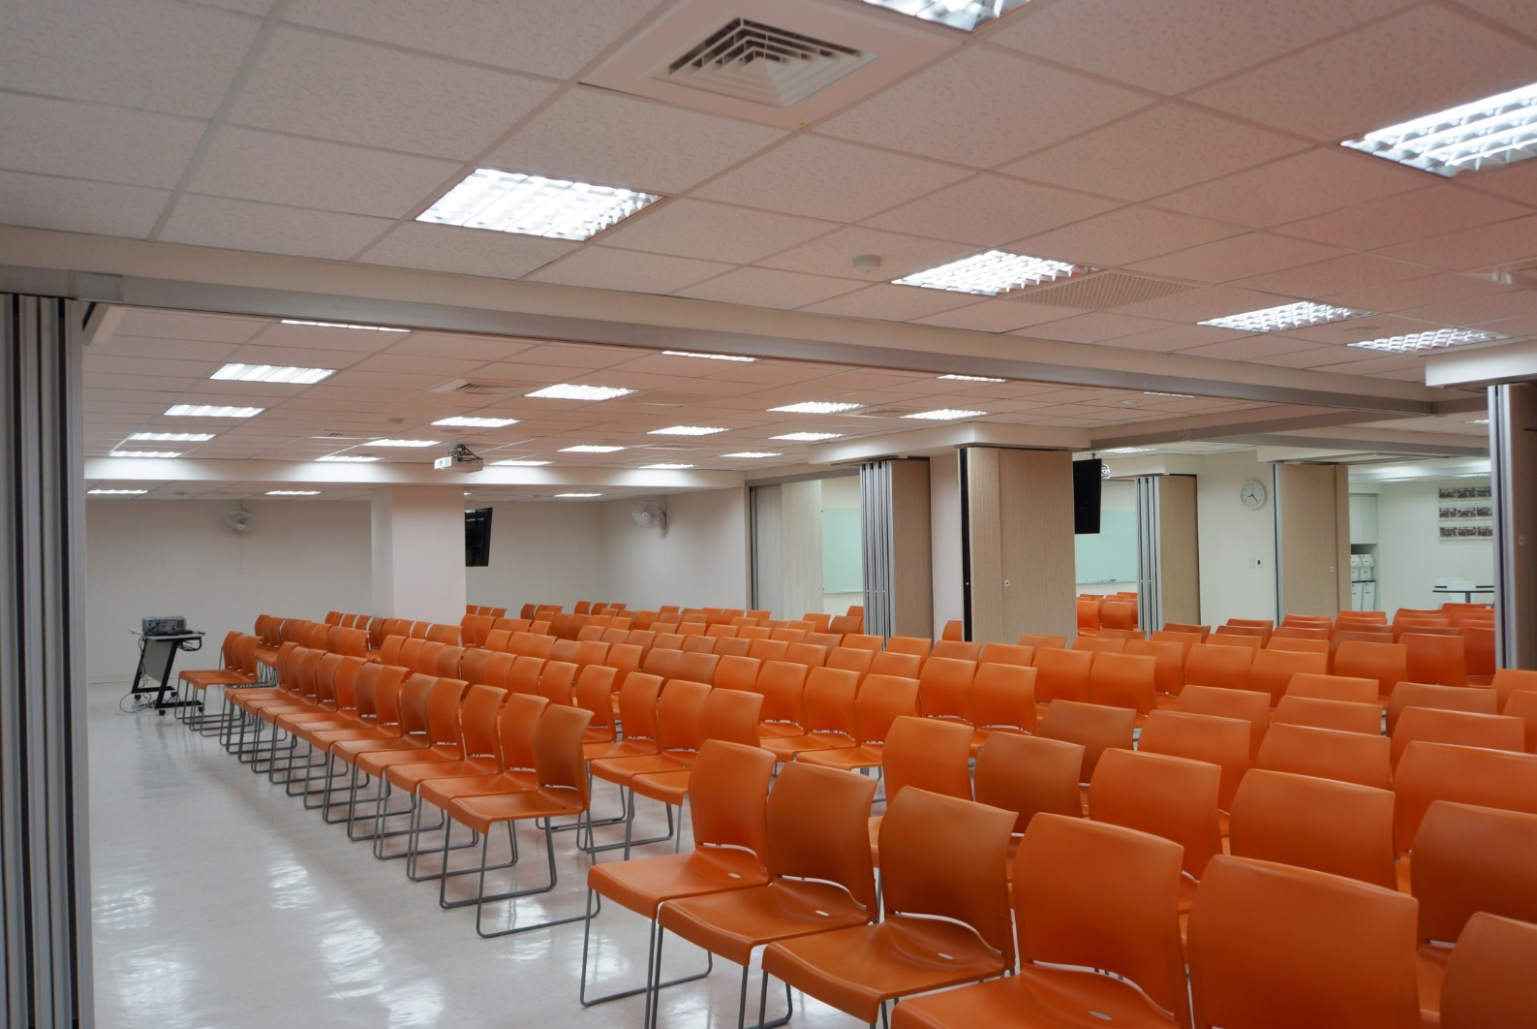
New Taipei Training Center
Better support all UFOs

Slide 17
New Showcase

Slide 19
Last 12 Months
01
Increased threshold to RMB3,000
Strengthened delivery process through Hong Kong hub
02
03
3X Increase in Sales
04
Building your Shopping Annuity

Slide 20
SHOP.COM
11.11 Appreciation Promotion
Offering 11% discount
for purchase RMB 1,000 or over
9 – 11 Nov
*Regular ordering rules apply, including order and quantity thresholds.

Slide 21
2019 Asia Pacific Events
 | Annual Convention
Hong Kong | Mar 29 - 31
Southeast Asia Convention (Singapore & Malaysia) | Apr 5 - 7
Taiwan | Apr 12 – 14
Australia | May 3 - 5
 | Product Symposium
Singapore | Jul 6 - 7
Taiwan | Jul 13 - 14
Hong Kong | Jul 20 - 21
Malaysia | Jul 21
 | Leadership School
Singapore | Oct 18 - 20
Malaysia | Oct 25-27
Taiwan | Nov 1-3
Hong Kong | Nov 8-10

